Slide 1
DATA WAREHOUSES · Summer 2025/2026
Bitcoin On-Chain
Data Warehouse
From Raw Blockchain to Multidimensional OLAP Analysis
657K+
4
10
7/10
Transactions
Dimensions
OLAP Queries
Queries Solved
Student ID: 293867 · Part 4 - Results · 23-06-2026
Álvaro Puebla Ruisánchez
Notes:
Welcome everyone. This presentation covers the results of the Bitcoin On-Chain Data Warehouse mini-project. The core idea: bridging two worlds that are rarely merged - Bitcoin's raw blockchain data and its market/sentiment signals - inside a single queryable star schema warehouse. We'll walk through architecture, ETL, the dimensional model, 10 OLAP queries against a live SSAS cube, and the Power BI management dashboard.

Slide 2
PRESENTATION OUTLINE
Presentation Structure
01
Project Goal & Dataset
→
05
Dimensional Model
→
02
Solution Architecture
→
06
OLAP Analysis (10 Queries)
→
03
ETL Process Design
→
07
Management Dashboard
→
04
ETL Implementation
→
08
Summary
→
Notes:
The heaviest focus - by design and by the grading criteria - is on ETL implementation, the dimensional model, and the OLAP analysis. The architecture and dataset sections are reminders to set context; the real substance starts with the ETL slides.

Slide 3
01 · PROJECT GOAL & DATASET
What We're Building - and Why
Core Research Question
"Has Bitcoin successfully evolved from a low-fee experimental payment system into a high-value settlement layer driven by market sentiment and protocol upgrades?"
ON-CHAIN
MARKET PRICE
SENTIMENT
DOMINANCE
mempool.space API
Yahoo Finance API
Alternative.me API
CoinLore API
Blocks: height, miner pool, weight, fees
Txs: inputs/outputs, SegWit, RBF, locktime
Daily BTC-USD OHLCV
(Open / High / Low / Close / Volume)
Fear & Greed Index (0–100)
Available from 2018-02-01
BTC market cap dominance %
vs total crypto market
TARGET USER
KEY QUESTIONS THIS DW ANSWERS
Blockchain Analyst / Researcher
Do people overpay fees when the market is gripped by fear?
Is Tuesday genuinely the most expensive day to send Bitcoin?
Has SegWit adoption changed how efficiently the network processes value?
Monitors on-chain settlement dynamics, fee pressure, and market-sentiment correlations to evaluate Bitcoin network capacity, protocol adoption, and macro-level valuation.
Notes:
The dataset is a hybrid of four APIs: Mempool.space for raw on-chain data (blocks and transactions), Yahoo Finance for daily BTC-USD price, Alternative.me for the Fear & Greed Index, and CoinLore for BTC market dominance. The target user is a Blockchain Analyst who needs to correlate network-level activity with market sentiment - something no single existing tool does out of the box. The core research question drives everything: has Bitcoin evolved from a cheap payment network into a high-value settlement layer? The three questions at the bottom are exactly the kinds of things our dashboard answers.

Slide 4
02 · SOLUTION ARCHITECTURE
Full-Stack Architecture
DATA SOURCES
PYTHON ETL
BTC_STAGING DB
BTC_DW DB
SSAS CUBE
POWER BI
Mempool.space
Yahoo Finance
Alternative.me
CoinLore
btc_pipeline.py
btc_pipeline_backwards.py
SQL Server
Raw landing zone
6 staging tables
SQL Server
Star Schema
4 dims + 1 fact
BTC_Analytics_Cube
MDX aggregations
Hierarchies & KPIs
Live Connection
MDX queries
Management Dashboard
→
→
→
→
→
TOOL JUSTIFICATIONS
Python over SSIS/Talend
Staging + DW Separation
SSAS Live Connection in Power BI
Mempool API returns HTTP 404 (not empty list) when a block has exactly 25/50 txs. Python's custom http_get(ignore_404=True) solves this; SSIS cannot handle it gracefully.
Also, because I love Python.
Staging preserves raw data intact for re-runs. DW contains only clean, conformed data. An ETL bug never corrupts the analytical layer.
657,968 rows (growing via backfill).
Live = Power BI sends MDX queries to pre-aggregated cube, never loading raw rows into RAM → sub-second dashboard response.
Notes:
The full stack: four APIs → Python ETL → BTC_Staging DB (raw landing zone) → BTC_DW (clean star schema) → SSAS Cube → Power BI live connection. Three key justification points: First - Python over SSIS. The Mempool API has a quirk: when a block has exactly 25 or 50 transactions and you request the next page, it returns HTTP 404 instead of an empty list. SSIS has no graceful 404 handler. Python's custom http_get with ignore_404=True solves this in three lines. Second - two separate databases. Staging keeps raw data intact so we can re-run ETL without touching the analytical layer. An ETL bug cannot corrupt the DW. Third - SSAS live connection. With 657,000+ rows (and growing), Power BI never loads raw data into RAM - it sends MDX queries to the pre-aggregated cube. Sub-second response times on every dashboard interaction.

Slide 5
03 · ETL PROCESS - DESIGN
ETL Pipeline: 4-Phase Design
01
02
03
04
EXTRACT
STAGE
TRANSFORM + DQ
LOAD
→
→
→
Watermark = MAX(height) from STG_BLOCKS
Fetch only newer blocks from Mempool API
Market data uses date-based watermarks
Paginated JSON, 10-25 records/page
STG_BLOCKS, STG_TRANSACTIONS
STG_TX_INPUTS, STG_TX_OUTPUTS
STG_MARKET_DAILY
STG_FEAR_GREED_RAW
Uniqueness: txid = 64-char hex, not in FACT
Completeness: output_value_sat ≥ 0
Consistency: script_type whitelist
Freshness: market date ≤ yesterday
SCD Type 1 (overwrite) for all dimensions
Bulk INSERT for FACT_TRANSACTION
Pre-computed columns in SQL (no Python math)
Upsert into Star Schema
DATA QUALITY GATES
Gate | Rule | On Failure
Uniqueness | txid = 64-char hex, not already in FACT | Log to ERR_QUALITY_REJECTS, skip row
Completeness | output_value_sat ≥ 0, block_hash resolves to DIM_BLOCK | Reject entire block batch
Consistency | script_type ∈ {P2PKH, P2SH, P2WPKH, P2WSH, P2TR, OTHER} | Map to 'OTHER', log
Freshness | Staging market date must be ≤ yesterday | Alert logged, load continues
Notes:
Four phases: Extract uses watermarks - MAX(height) for blocks, date-based for market data - so every run only fetches new data. Stage flattens JSON into six staging tables, one per data entity. Transform applies four DQ gates: uniqueness, completeness, consistency (script_type whitelist), and freshness. Failures go to an error log table - never silently swallowed. Load uses SCD Type 1 (overwrite) for all dimensions - Bitcoin block data is append-only so overwrites are safe - and bulk INSERT for the fact table. All derived columns (fee_burden_pct, io_value_ratio, etc.) are computed in SQL during the load, not in Python.

Slide 6
04 · ETL PROCESS - IMPLEMENTATION
Technical Highlights & Bug Fixes
AUTONOMOUS BACKWARD BACKFILL
HARD BUGS SOLVED
btc_pipeline_backwards.py
Arithmetic Overflow
Queries MIN(height) from staging → finds history gap
Fetches blocks in batches of 200, walking toward block 0
Commits each batch fully before starting the next
Resumable: Ctrl+C stops safely - restart picks up exactly where it left off
Self-healing: 3 consecutive empty batches trigger a safety exit (anti-infinite-loop guard)
Problem: pyodbc inferred satoshi values as tinyint (max 255 vs 2.1×10¹⁵ sat)
→ Fix: Added CAST(? AS BIGINT) in every INSERT
Msg 1934 DDL Error
Problem: QUOTED_IDENTIFIER OFF prevents computed column creation
→ Fix: SET QUOTED_IDENTIFIER ON in all DDL scripts
404 Pagination Crash
Problem: Mempool API returns 404 (not empty list) at page boundary (25/50 txs)
→ Fix: ignore_404=True param in http_get() returns [] and breaks loop
NVT/Fear-Greed Not Loading
Problem: load_ts not bumped when staging updated → DW thought data unchanged
→ Fix: Always update load_ts after merge, forcing SCD-1 UPDATE to propagate
Notes:
Two implementation highlights worth dwelling on. The backward backfill pipeline is a second independent script. It starts from the oldest block we have and walks backward toward block 0 in batches of 200. It's fully resumable - Ctrl+C stops it, restart picks up exactly where it left off. A three-empty-batch guard prevents infinite loops. The four bugs on the right were all discovered during implementation and are worth discussing: - The arithmetic overflow - pyodbc silently inferred satoshi values as tinyint (max 255) despite Bitcoin having up to 2.1×10^15 satoshis. The fix was explicit CAST(? AS BIGINT) in every INSERT. - The 404 crash - already covered in the architecture slide. - The NVT/Fear-Greed sync issue was subtle: load_ts wasn't being bumped after a staging merge, so the DW thought the data was unchanged and skipped the SCD-1 update. Always updating load_ts after any merge fixed it.

Slide 7
05 · DIMENSIONAL MODEL
Star Schema: FACT_TRANSACTION
DIM_DATE
DIM_MARKET
SCD Type 1
SCD Type 1
Year / Quarter / Month / Day
Day of Week
Halving Era (1–5)
Difficulty Tier
FACT_TRANSACTION
Price / Market Cap
Fear & Greed Score (0–100)
Fear & Greed Label (text)
BTC Dominance %, NVT Ratio
Grain: one row per transaction
· fee Currencies (Sat, Btc, Usd)
Transaction Count
· input/output value (Sat, Btc, Usd)
· fee_usd
· fee_burden_pct
DIM_BLOCK
Tx Size Bytes
DIM_TX_TYPE
Tx Vsize Bytes
SCD Type 0 (Immutable)
Tx Weight Units
Junk Dimension - SCD Type 1
Block Height
Hash
Miner Pool Name & Slug
Total Size, Weight, Tx Count
Difficulty
script_type_desc
segwit_flag
coinbase_flag
rbf_flag, locktime_flag
Notes:
Grain: one row per transaction. This is the most atomic useful grain - we can always roll up to block or day, but can never drill down if we start coarser. Four dimensions: DIM_DATE - the richest dimension. Includes Halving Era (1–5, derived from block height ranges) and Difficulty Tier (Low/Medium/High/Extreme, derived from network difficulty). These enable the most interesting cross-era and cross-tier analyses. DIM_BLOCK - SCD Type 0 because blocks are cryptographically immutable once mined. DIM_MARKET - daily snapshot, SCD Type 1 overwrite. DIM_TX_TYPE - this is a junk dimension. Five boolean flags (segwit, coinbase, RBF, locktime, script_type) are grouped into one dimension instead of adding five columns to the fact table. This keeps the star schema narrow and clean. The two starred measures - fear_greed_score and market_cap_usd - are denormalized directly into FACT to avoid an extra join on the hottest query paths. Honest reflection: input_count and a DIM_SIZE_TIER were identified as missing after OLAP testing.

Slide 8
06 · OLAP ANALYSIS
10 Queries - Status Overview
7
2
3
Era 5
Fully Answered
Partially Answered
Structurally Impossible
Data Coverage
✓ SOLVED
Q1.1 - SegWit Adoption Rate by Quarter
✓ SOLVED
Q1.2 - Fee-Rate Spikes Under Network Congestion
89.62% SegWit-native in 2026 Q2
June: higher fee rate (18.97) but lower fee burden (6.14%)
✗ N/A
Q1.3 - Fee Burden by Transaction Size Tier
✓ SOLVED
Q1.4 - Tx Volume vs. Fear & Greed Index
No DIM_SIZE_TIER dimension → impossible without DAX bucket
Extreme Fear dominates: 370K txs, $205.5B output value
✗ N/A
Q1.5 - Multi-Input vs. Single-Input Structure
~ PARTIAL
Q1.6 - Transaction Evolution Across Halving Eras
input_count exists in staging but not promoted to FACT
Only Era 5 populated; backfill in progress
✓ SOLVED
Q1.7 - Coinbase vs. Standard Composition
✗ N/A
Q1.8 - NVT Ratio Under Sentiment Regimes
Coinbase = 1% by count, 0.40% by BTC value - subsidy minimal in Era 5
Market cap approximated + only 47 days of data → insufficient
~ PARTIAL
Q1.9 - Block Space Efficiency by Difficulty Tier
✓ SOLVED
Q1.10 - Weekend vs. Weekday Fee Patterns
All txs in single 'Extreme' tier - cross-tier comparison impossible now
Sunday = cheapest (14.57 sat/vB) · Tuesday = peak (24.07 sat/vB)
Notes:
All 10 queries from Stage 1 were tested against the live SSAS cube via Power BI. 7 fully answered with live pivot results. 2 partially answered - only Era 5 is loaded so cross-era comparisons show a single data point. 3 correctly identified as structurally impossible - and this is worth emphasizing. We documented the exact technical reason for each impossibility rather than silently omitting them. Q1.3 needs a DIM_SIZE_TIER that doesn't exist. Q1.5 needs input_count in FACT, which was not promoted from staging. Q1.8 requires a proper market cap column and more historical data than we have. This kind of honest gap analysis demonstrates real design reflection and is more valuable than glossing over limitations.

Slide 9
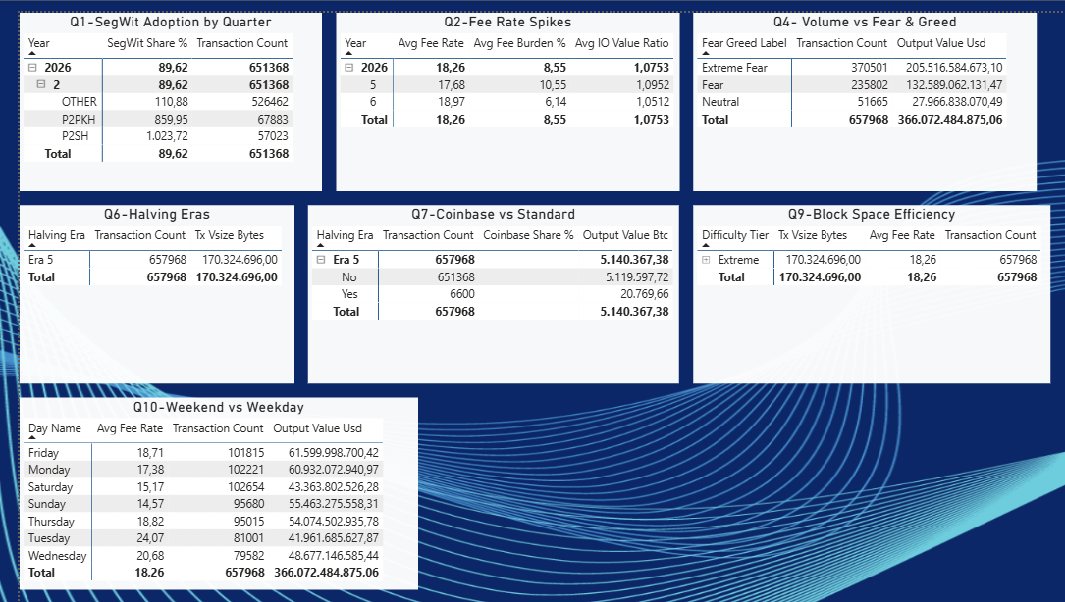
06 · OLAP ANALYSIS

Slide 10
06 · OLAP ANALYSIS - KEY FINDINGS
5 Standout Results from Live SSAS Cube
Q1.4
Fear = More Activity
Q1.10
Tuesday = Most Expensive Day
Counter-intuitive: Extreme Fear days account for 370,501 txs ($205.5B output). No Greed/Extreme Greed observed - market was in persistent fear throughout Era 5 Q2 2026. Consistent with panic-selling or accumulation during downturns.
Avg fee rate: Tuesday 24.07 sat/vByte · Sunday 14.57 · Saturday 15.17. Institutional settlement concentrated on business days creates a 30–40% weekend fee discount. Volume peaks Saturday (102,654 txs) and Monday (102,221).
Q1.1
SegWit Already Won
Q1.2
Fewer Txs = Efficient Fee Absorption
89.62% of 651,368 non-coinbase transactions in Q2 2026 are SegWit-native. P2PKH (legacy) is now the minority segment with 67,883 txs. Full S-curve trajectory not yet visible (only Era 5 loaded).
May 2026: 10.55% avg fee burden. June 2026: fee rate rose to 18.97 sat/vByte but fee burden fell to 6.14%. Fewer but higher-value txs in June absorbed fees more efficiently. IO Value Ratio ≈ 1.05–1.10 both months.
Q1.7
Coinbase Share is Minimal in Era 5
6,600 coinbase txs out of 657,968 total (1.00% by count). Output value: coinbase = 20,769 BTC vs standard = 5.12M BTC (0.40% share). Confirms block subsidy is now economically marginal - fee revenue is the emerging security model.
Notes:
Five results worth highlighting: Q1.4 - Fear drives activity. Counter-intuitively, Extreme Fear days account for the most on-chain volume: 370K transactions, $205B in output value. This is consistent with panic-selling or accumulation during downturns. No Greed observations exist - the market was in persistent fear throughout Q2 2026. Q1.10 - Tuesday is the most expensive day to send Bitcoin. 24.07 sat/vByte on Tuesdays vs 14.57 on Sundays. Institutional settlement concentrated on business days creates a 30–40% weekend discount. This is directly actionable for anyone transacting on-chain. Q1.1 - SegWit has essentially won. 89.6% of non-coinbase transactions are SegWit-native. Legacy P2PKH is now the minority. Q1.2 - Efficiency matters more than raw fee rate. June had higher fee rates than May but lower fee burden, because larger-value transactions absorbed fees proportionally better. Q1.7 - Block subsidy is becoming economically marginal in Era 5. Coinbase transactions represent only 0.4% of BTC value moved. The network is moving toward a fee-based security model - slowly, but measurably.

Slide 11
07 · MANAGEMENT DASHBOARD
Power BI Dashboard - Live SSAS Connection
01
Strategic Anchor
02
Historical Evidence
03
Structural Drivers
Network Fee Sustainability KPI Card
(traffic-light: Red/Yellow/Green)
Settlement vol + Fee rate over time
SegWit adoption trajectory (100% stacked bar)
Sentiment-volume scatter · Difficulty tier bar
Miner revenue donut · Day-of-week heatmap
7 DASHBOARD VISUALS
1
Card
→ Red (0.00) - subsidy still dominant in Era 5
2
Dual-Axis Line
→ May→June: output fell, fee rate rose (divergence pattern)
Network Fee Sustainability Score
Settlement Volume vs. Avg Fee Rate over Time
3
100% Stacked Bar
→ 89.6% SegWit-native in Q2 2026
4
Scatter Plot
→ Extreme Fear days cluster highest output values
SegWit vs. Legacy Script Adoption by Quarter
F&G Score vs. Daily Settlement Volume
5
Horizontal Bar
→ 8.55% for sole 'Extreme' tier (single-tier dataset)
6
Donut Chart + Filter Era
→ P2PKH = 84.1% of BTC value (4.32M BTC)
Avg Fee Burden (%) by Difficulty Tier
Output Value BTC by Script Type
7
Matrix
→ Sunday cheapest · Tuesday most expensive · actionable!
Avg Fee Rate: Day of Week × Halving Era
Notes:
The dashboard follows a deliberate reading flow: top-left to bottom-right, moving from strategic headline to structural drivers. Chapter 1 is a single KPI card - the Network Fee Sustainability Score. Before the analyst reads any chart, they get a traffic-light signal on the most important strategic question. Chapter 2 provides historical evidence: the dual-axis line chart shows the May-June fee divergence pattern, and the stacked bar shows SegWit adoption progress. Chapter 3 covers structural drivers: the scatter plot correlates sentiment with settlement volume, the horizontal bar shows fee burden by difficulty tier, the donut shows output value by script type, and the heatmap gives the day-of-week fee seasonality - the most tactically useful insight, placed last as a reward for careful reading. All 7 visuals connect live to the BTC_Analytics_Cube via Analysis Services. No Power BI-level DAX columns were needed. Note on the KPI Card: it currently shows Red (0.00). This is either a KPI goal misconfiguration in SSAS, or a genuine reflection that coinbase subsidy still dominates miner revenue at the block-reward level in Era 5.

Slide 12
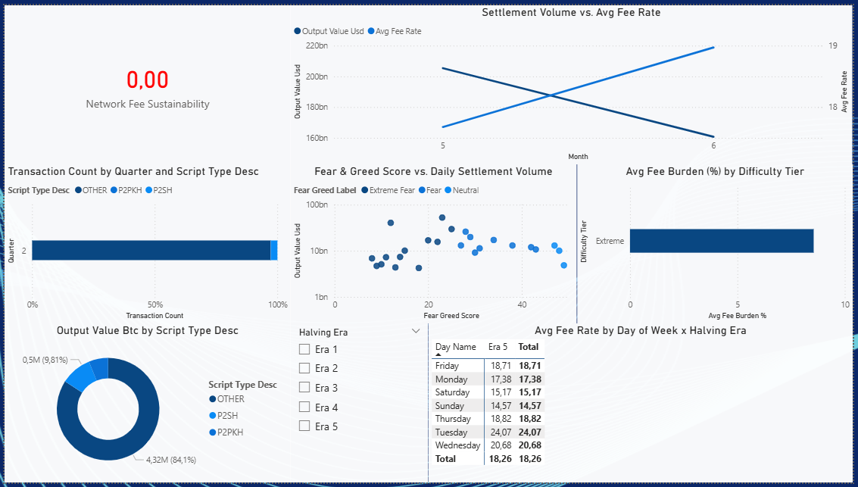
07 · MANAGEMENT DASHBOARD

Slide 13
08 · SUMMARY & LIMITATIONS
Project Outcomes & Next Steps
✓ WHAT WAS ACHIEVED
! PRIMARY LIMITATION
Full ETL pipeline: 2 Python scripts, 6 staging tables, 4 DW dimensions, 1 fact table
SSAS multidimensional cube + Power BI live connection dashboard
657,968 transactions loaded (and growing via backfill)
10 OLAP queries: 7 answered with live results, 3 correctly identified as structurally impossible
Unanswerable queries documented with precise technical justifications - not silently omitted
Dataset covers only Era 5 (May–June 2026) - cross-era comparisons analytically limited with a single era
Several dashboard visuals trivial: difficulty tier bar (1 tier), heatmap (1 era column)
Fix underway: btc_pipeline_backwards.py downloading historical blocks toward Era 1 - all cross-era queries auto-populate as it progresses
V2 MODEL ADDITIONS
Add input_count to FACT_TRANSACTION → unlocks Q1.5
Add DIM_SIZE_TIER dimension → unlocks Q1.3
Add circulating supply fact table → enables precise NVT
2
6
5
1
7
Python Scripts
Staging Tables
DW Tables
SSAS Cube
Power BI Visuals
Notes:
What was delivered: a complete, end-to-end data warehouse from API to dashboard. Two Python scripts, six staging tables, five DW tables (four dimensions plus one fact), one SSAS cube, one Power BI dashboard with seven visuals. Seven OLAP queries answered live; three documented as structurally impossible with precise technical justifications. The primary limitation is data scope - only Era 5 (May-June 2026) is loaded. The backward backfill pipeline is actively fixing this; as it progresses, all cross-era comparisons auto-populate without any code changes. Three concrete v2 additions have already been identified: input_count in FACT, a DIM_SIZE_TIER bucketed dimension, and a circulating supply fact table for proper NVT computation.

Slide 14
Thank You
Questions & Discussion
657K+
7 / 10
Era 5
Live
Transactions
Loaded
OLAP Queries
Answered
Data Coverage
(backfill ongoing)
SSAS Cube
Power BI Connection
Bitcoin On-Chain Data Warehouse · Student ID: 293867 · 23-06-2026
Notes:
That concludes the presentation. Happy to take questions on any component - the ETL implementation, the dimensional model design decisions, the OLAP query results, or the dashboard.

